Slide 1
Void Management

Slide 2
Overview
As part of the larger Connect platform, <CRE Client> has successfully implemented Salesforce to manage the Lead-to-Lease process. This has transformed both internal operations and the customer journey. <CRE Client> are now looking to leverage Salesforce to realise similar benefits for the Void Management process.
<CRE Client> have engaged with Open Box to design a future-state Void Management process that can be implemented in their existing Salesforce org and aligns with Salesforce features and best practices.
Current Challenges with the Void Process:
No Visibility into Team Activity
Limited Performance Metrics
Lack of Ownership
Many Teams & Systems Involved
No Visibility into Comms over Email
Limited System Integration
Process Inefficiencies & Variations

Slide 3
Business Drivers
<CRE Client> are planning on significant expansion, looking double their number of letting homes in the next 3-4 years.
The current systems and processes used in void management are not scalable to support this.
Leveraging the existing Salesforce platform and user licenses will help to:
Improve speed & efficiency
Reduce errors
Allow the business to scale operations without necessitating a linear increase in employee headcount
Minimize the time that units remain vacant
Improve customer satisfaction - reduce the risk of not cancelling direct debits or returning deposits on time & create a single view of customer

Slide 4
Vision and Objectives
Project Vision :
A centralized, standardized void workflow that tracks the end-to-end void progress, minimizes delays, and provides visibility into upcoming work, expected timelines & responsibilities.
The solution will be delivered in increments, providing tangible business value on a regular basis.
Key Objectives :
Measure Targets, Timeframes & KPIs
Visibility into Progress, Delays & Forecasted Completion
Visibility into Team Workload
Standardise Process while Allowing for Flexibility
Automate Notifications to Internal Teams
Move Towards Single View of Customer & Property
Clear Responsibility

Slide 5
Context Diagram

Slide 6
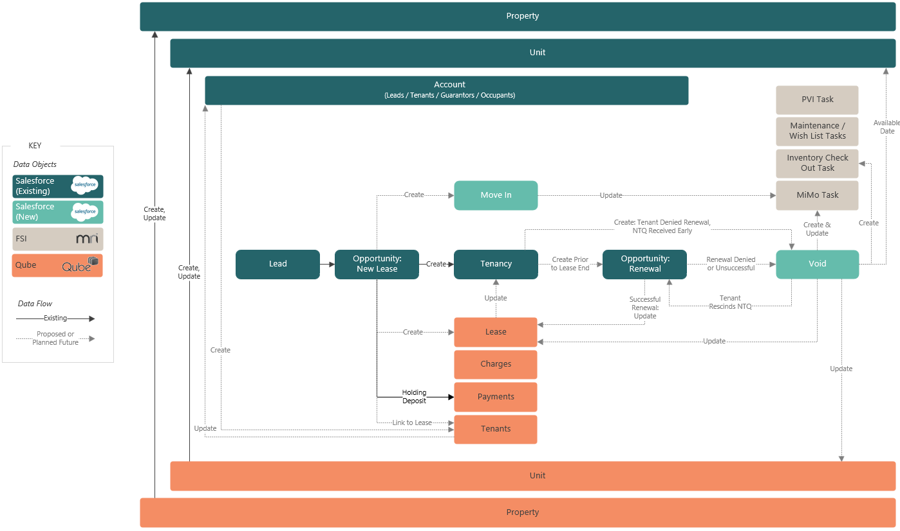
Future-State Process: High Level Tenant Lifecycle & Data Flow

Slide 7

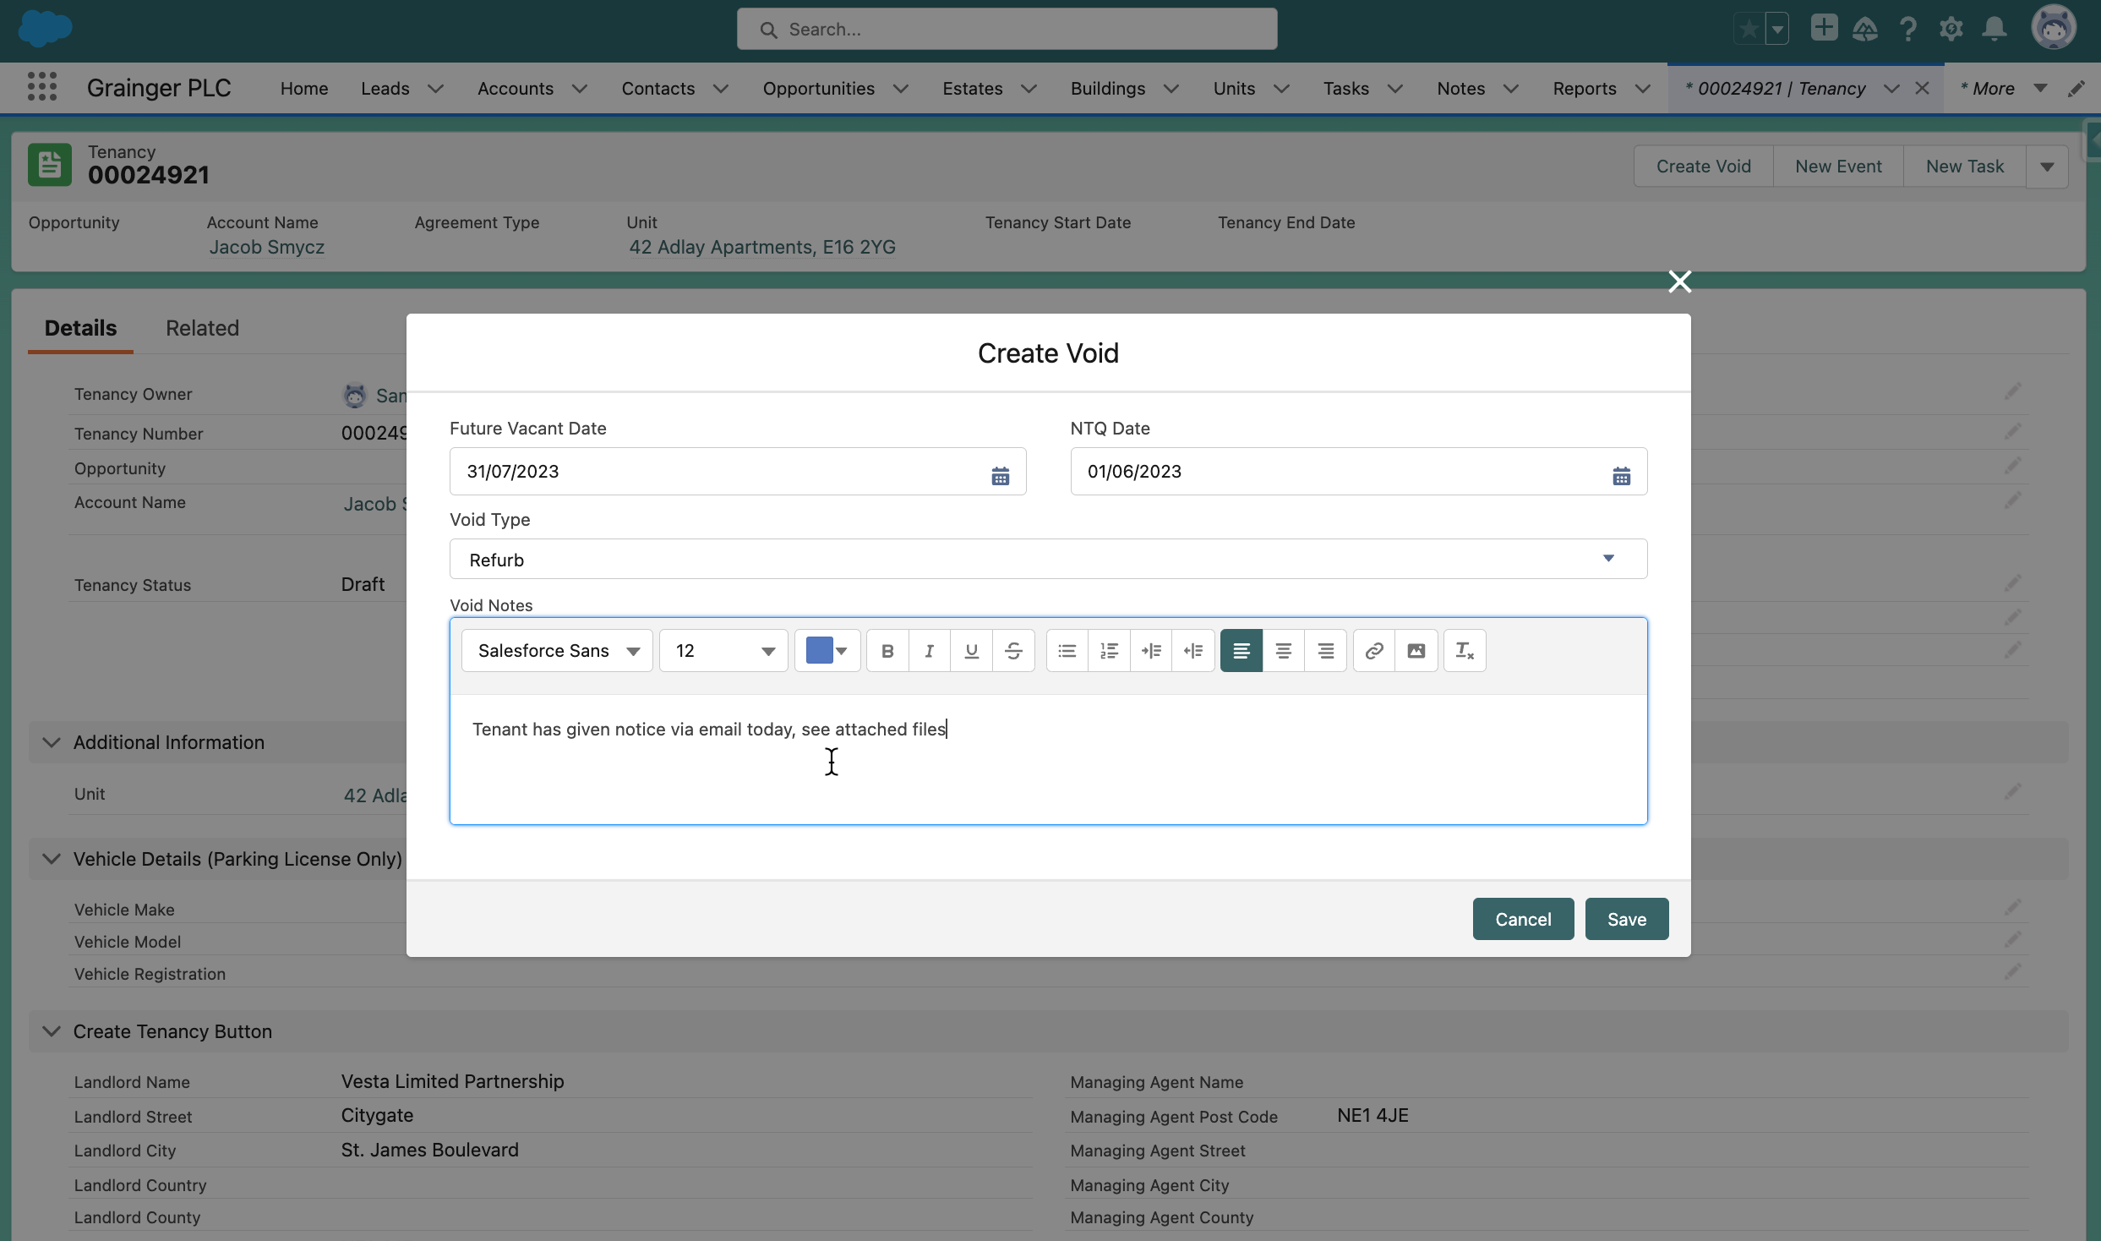
Proof of Concept
CRE Client
Initiate a new void from the relevant Tenancy

Slide 8
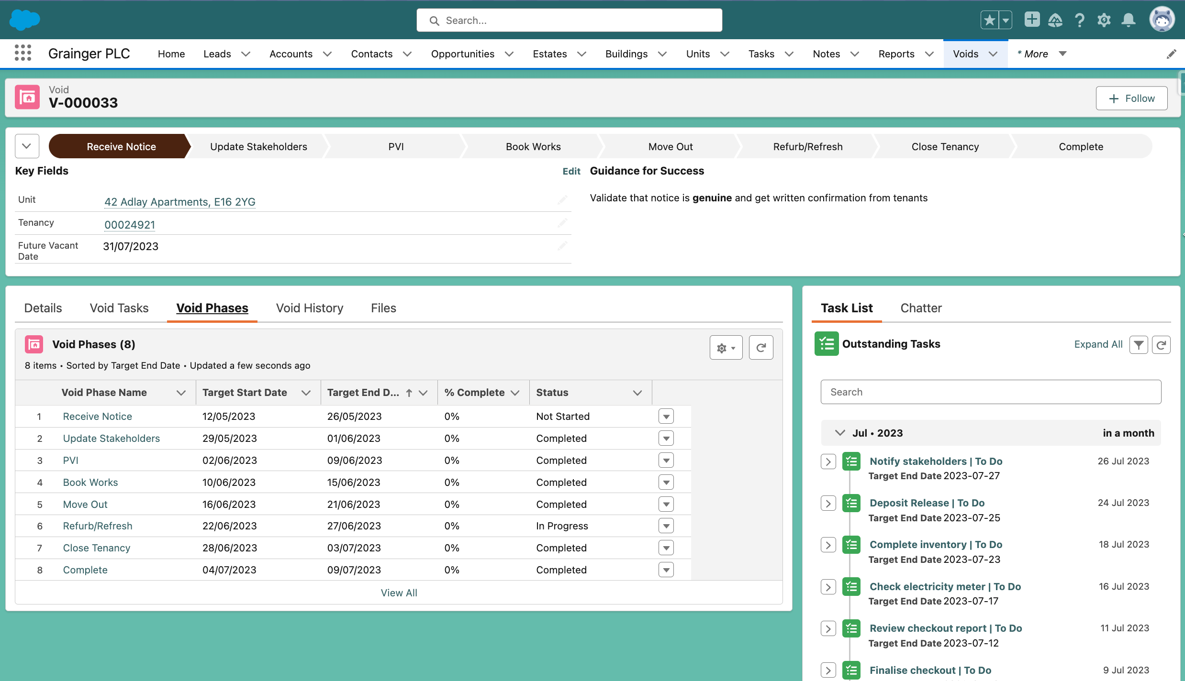
Proof of Concept
Void record creates single source of truth for collaboration & tracking of all void activities
CRE Client
Phases with projected start & end dates
Tasks created with due dates based on void start & future vacant date

Slide 9
Proposed Roadmap
Release 1
Future
Create & Complete End-to-End Void Workflow
Calculating & Revising Estimated Timelines
Update Salesforce Unit
User/Team Task Lists
Dashboards - KPIs & Voids Behind Schedule
See Voids by Unit & Building
Property Calendar of Onsite Void Tasks
Upload Void Documents
Audit History
Replace Internal Notification Emails
Qube Integration
EPCs
FSI Integration
Enhanced Property Calendar (Include Viewings & Other Building Activity)
Advanced Dashboards (Trends & Comparisons)
Online Tenant Instructions (DRI)
Additional Void Workflows (Tenant Already Vacated, Give Notice to Vacate, Garage & Parking Bay Voids, Tenant Rescinds NTQ, Custom Tasks)
Additional Task Details (Refurb, PVI Checklist, Detailed Works)
Incorporate Delays
Automated Emails to Tenants (Move In & Move Out)
Customizing Turnaround Times, Non-Working Days
Void Variations - Unit Sale, Relet, ​ Clean vs Refurb vs Refresh
Auto Assign Tasks to Individuals
2023
1
July
30 Sept
Notes:
Release 1
This is at the current point in time, likely to change as the project progresses. But it is put together based on the process we’ve designed with Scott and Jacob and is tied to the demo we’ve built to showcase the hypothesized design with phases and tasks. i.e. we are not just grouping random development items, we are choosing the “stripe” of functionality required to cover the void process end-to-end.
Release 1 requirements:
No additional licenses (assuming all actors already have licenses)
No new integrations
No migration of historical data
Data/file volumes may require archival strategy in the future
Items outside of void process
Building out renewal functionalty to be integrated with voids & tenancies
Move In workflow
Pricing playbook
Tenant arrears in Salesforce
Complaints register
Minimising double entry in Hive
We have sprint 1 ready to go, we are ready to go in July

Slide 10
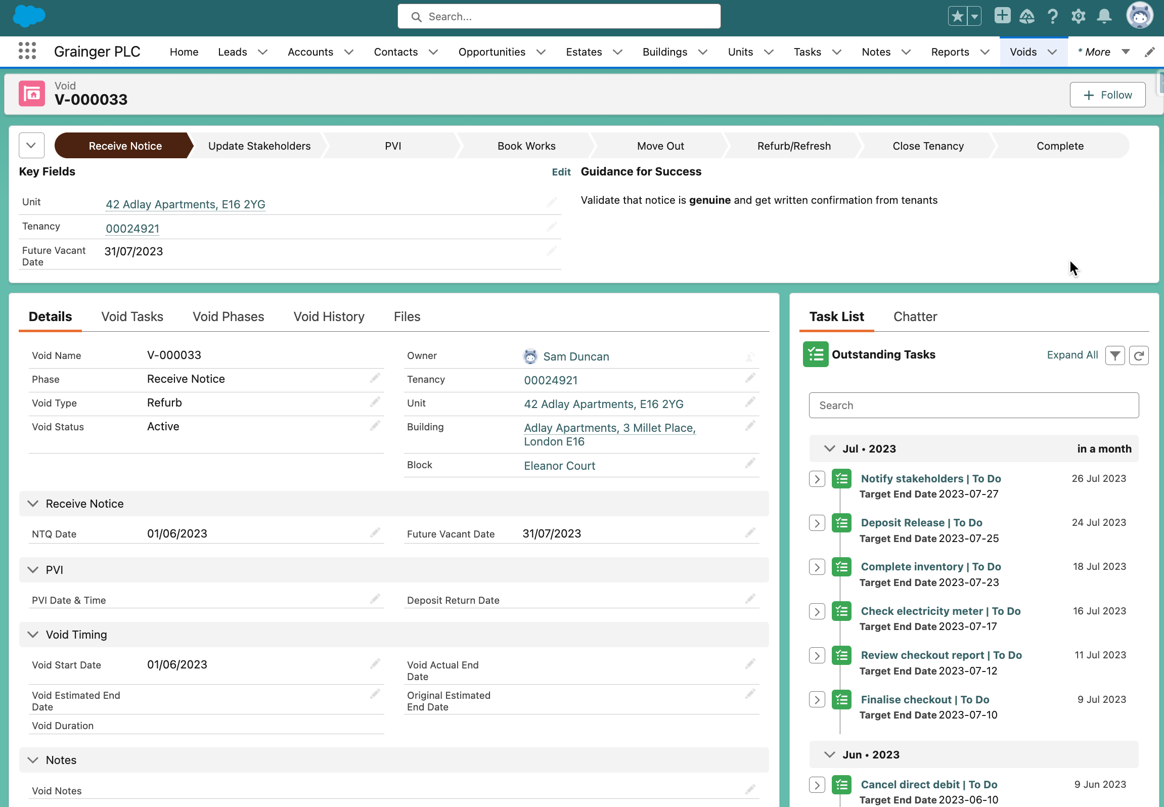
Proof of Concept
Void record creates single source of truth for collaboration & tracking of all void activities
CRE Client
Tasks created with due dates based on void start & future vacant date

Slide 11
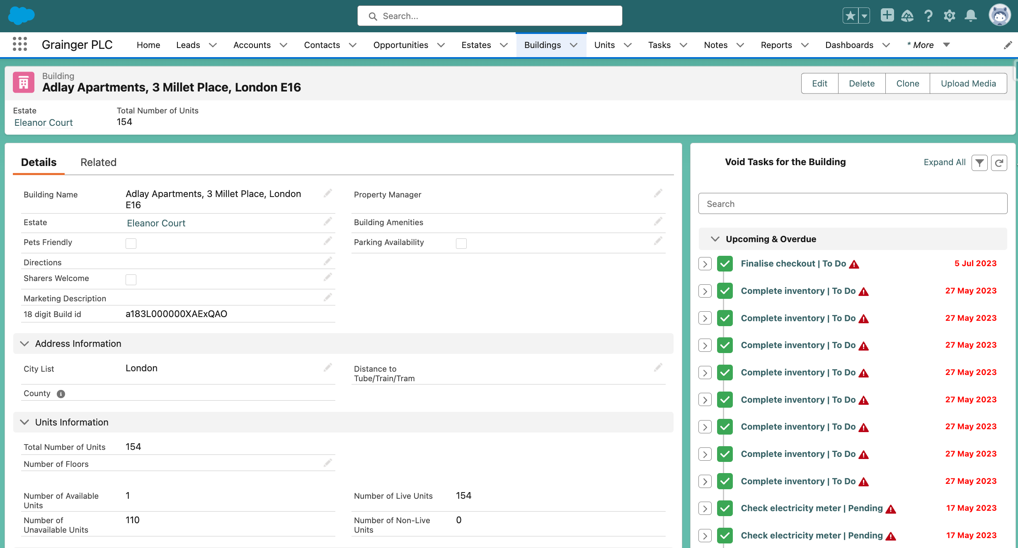
Proof of Concept
CRE Client
Consolidated view of tasks at building level

Slide 12
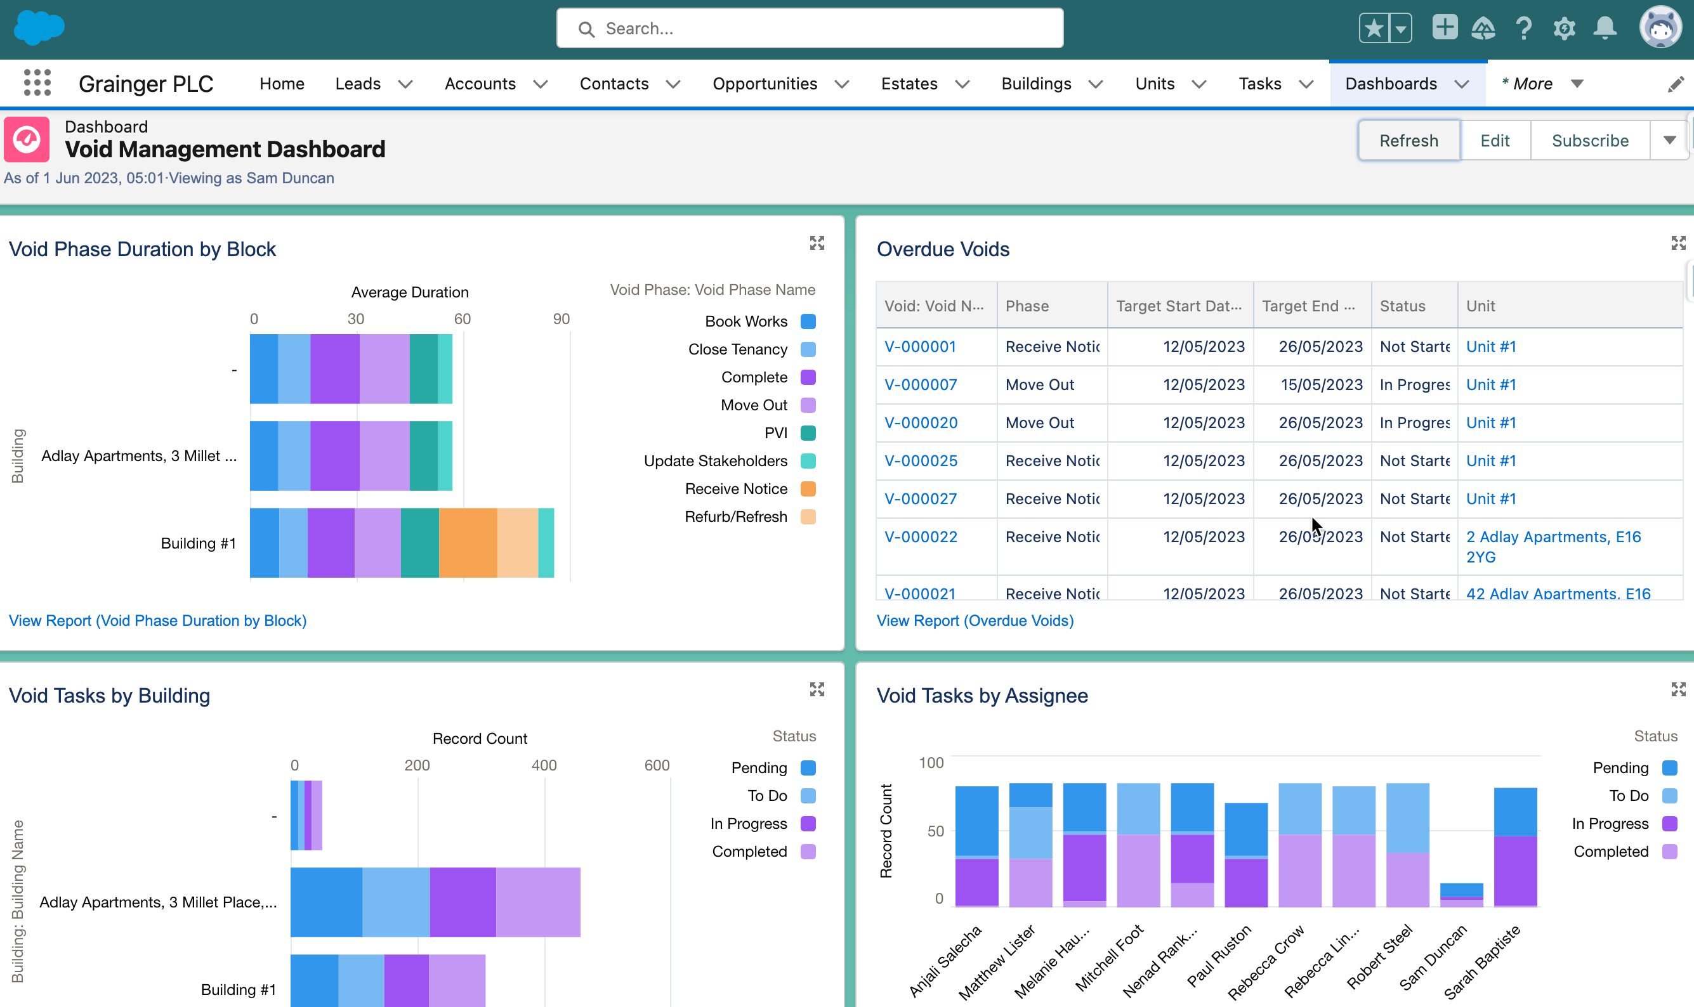
Proof of Concept
Reports & Dashboards to give visibility into KPI's, overdue tasks, workload by user, etc.
CRE Client

Slide 13

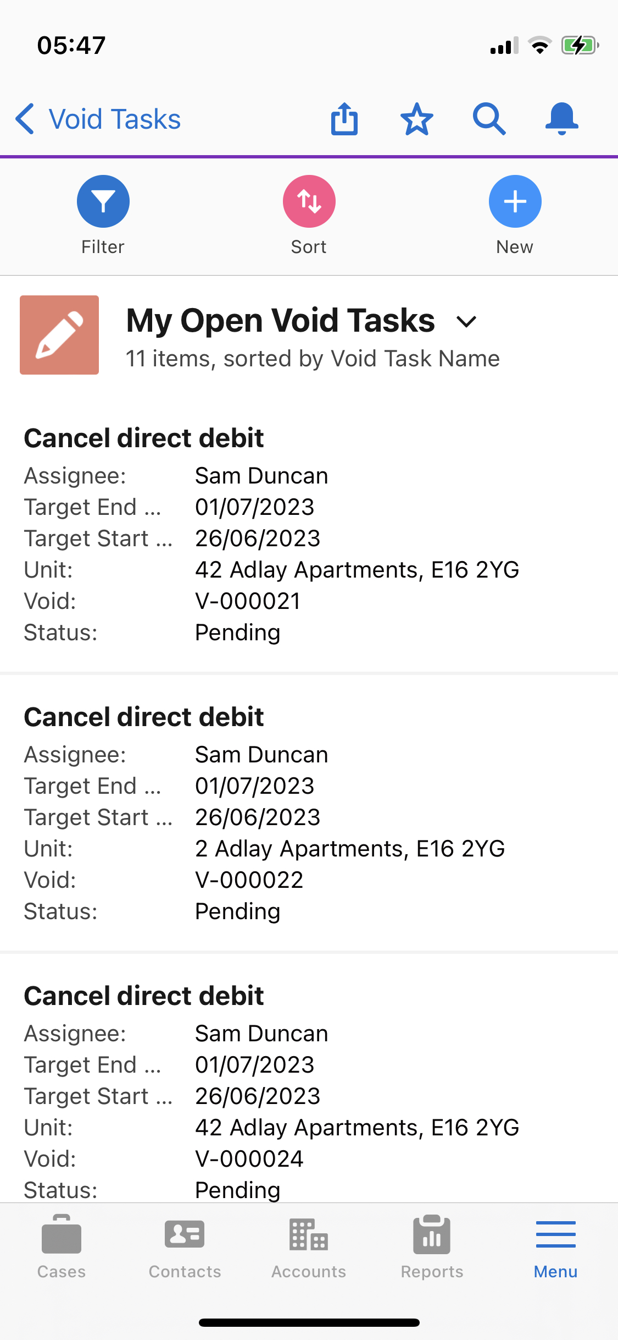
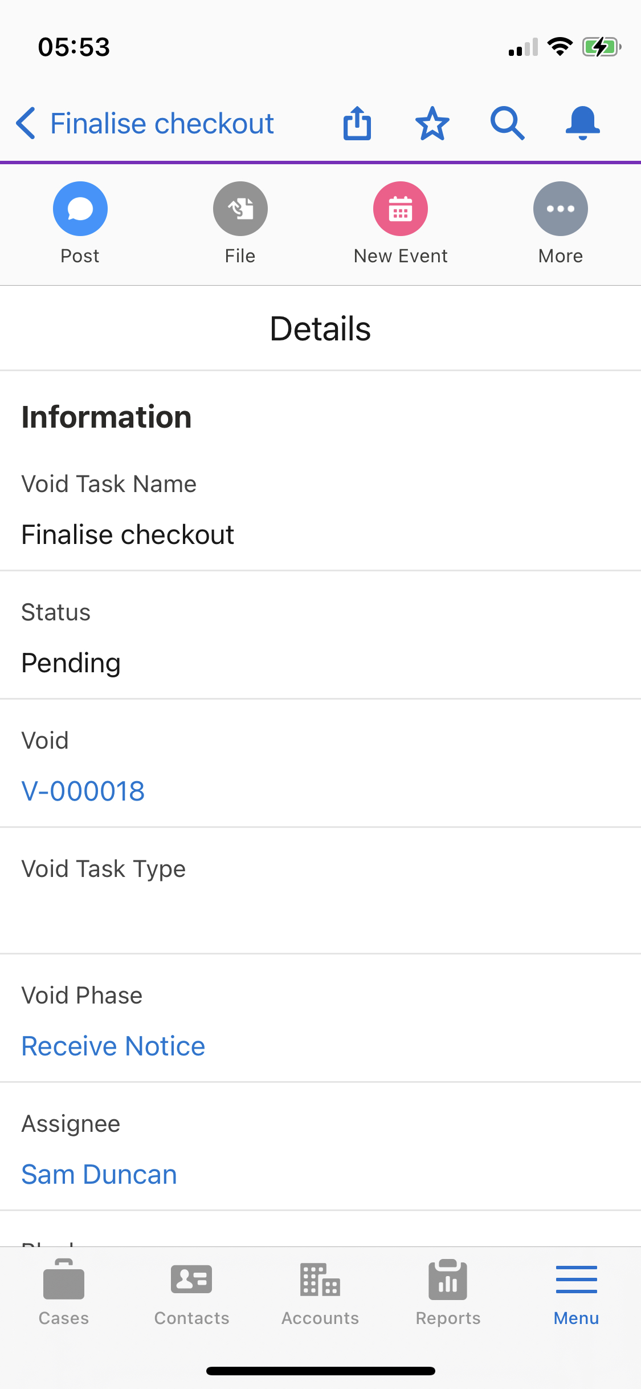
Proof of Concept
View and complete tasks on the mobile app
Attach photos

Slide 14
Non-Financial Benefits
Enhance Data Visibility
Improve decision-making & resource planning
Reduce costs of temporarily rehousing new tenants if a tenant refuses to move out
Improve Accuracy & Reduce Errors
Enhance Collaboration
More accurate predictions of future works required, budget & timelines
Reduce
# of deposits not returned in required timeframe (currently 10-15%)
Incorporate move out & renewal information into single view of tenant
Improve Tenant Experience
Build on 360° View of Property & Unit
Faster response times
Integrate with future complaints module
Consolidated view of building-level activities
Improve ESG Performance
Multiply efficiencies already realised @ Clippers Quay with a consolidated view of void tasks
Reduce # of people & visits (carbon footprint) required to complete onsite activities

Slide 15







Improving Speed & Efficiency
Benefits to Improve Efficiency
Consolidated view of building-level activities.
Time saved by automating the manual process.
Automated alerts & team handovers
Fewer emails.
Fewer spreadsheets & trackers to maintain.
Ensuring required information is completed.
Centralized & accessible information.
Currently 20 Portfolio Managers spend 30% of their time working on voids.
6 FTEs
33% less time to complete a void
Reduce onsite visits from 6 to 4 per void
Immediate Gains
Future Gains
Immediate Gains
2 FTEs become available to assist TPT, Renewals & PM processing 2,000 new units this summer
Portfolio managers able to process 50% more voids.
Planned portfolio growth over next 4 years to
increase units by 100%
would require
33% increase in void resources
Hire fewer temporary staff @ £2,000 pm
Savings £4,000 pm

Slide 16

Improving Turnaround Times Improving Tenant Retention
Benefits to Improve Tenant Retention
Benefits to Improve Void Turnaround
Single view of tenant
Confirm tenant’s intention to renew earlier
Additional time to address tenant issues
Improved tenant satisfaction
Improved visibility into void pipeline.
Identify voids behind schedule.
Immediate notification of tasks ready to complete.
Increase tenant retention by 1%
Increase refurbs started at move out from 40% to 80%
Reduce average void turnaround time from 7 to 5 days
Gains
96 Fewer voids annually
7 days additional rent: £36,960 p.a.
Saving an average £2,420 in cleaning /
refurb / refresh costs: £232,320 p.a.
Saving 20 hours employee time per void on move out, marketing, leasing & move in activities:
1 FTE @ £34,560 p.a.
Gains
Earning 2 additional days’ rent on 3,840 voids p.a. @ average £55 daily rent:
Additional rental income £422,400 p.a.

Slide 17
ROI Summary
Increased Annual Revenue | £ | Total
Additional rental income from faster void turnaround | 422 400
Additional rental income from improved retention | 36 960
Total |  | £ 459 360
Annual Cost Savings | £
Refresh/ refurb / cleaning costs saved from improved retention | 232 320
Temp cost savings from process efficiencies | 16 000
FTE / new hire savings from improved retention | 34 560
Total |  | £ 282 880
Overall Estimated Annual Benefit |  | £ 742 240

Slide 18
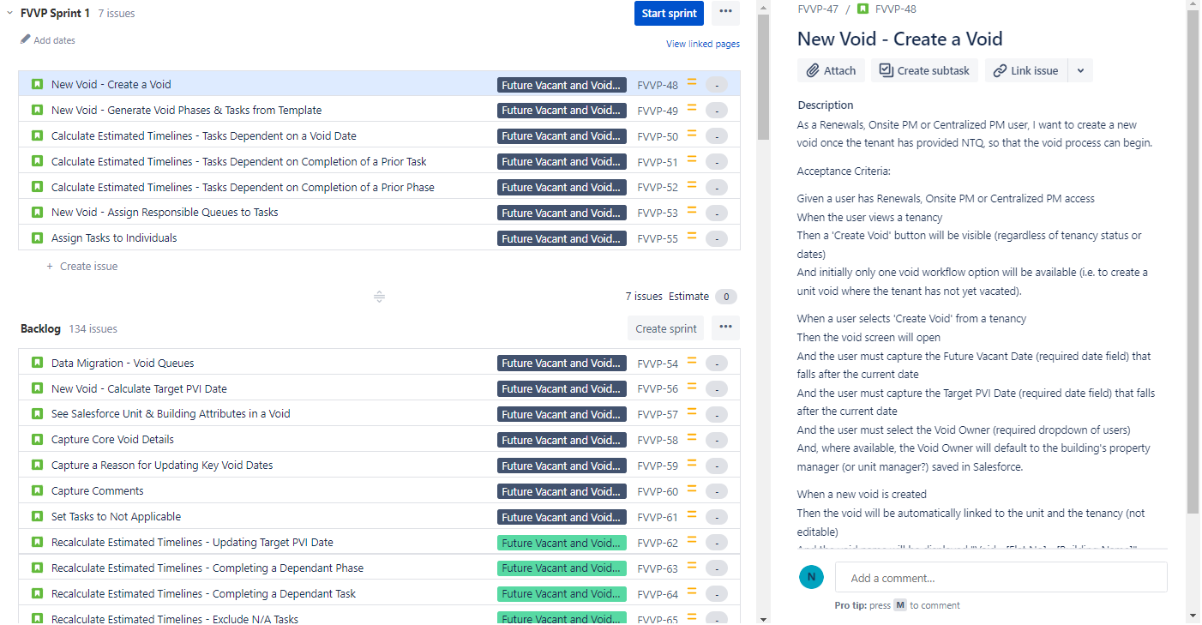
Jira Feature Backlog

Slide 19
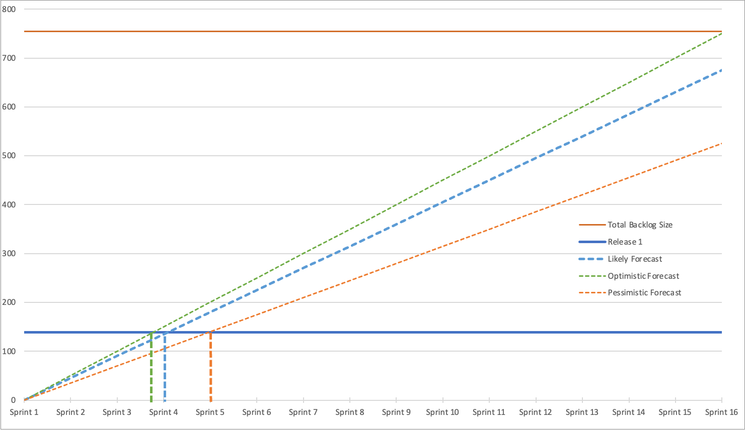
Release 1 Forecast
Likely: 4 sprints = 12 weeks

Slide 20






Project Team & Forecasted Costs
Open Box Delivery Team
1 Month
Release 1
Salesforce Architect
Business Analyst
Developers
Quality Assurance
Project Manager
4 sprints
520
effort
hours / month
3 months
<CRE Client> Delivery Team
£
duration
Product Owner - Main point of contact
monthly cost
£
Subject Matter Experts Project Sponsor - Involved in Demos & UAT
Change Management & End User Training Specialist
total cost
Notes:
All figures are forecasted as at current business asks

Slide 21
Next Steps
<CRE Client> to confirm they would like to move forward
Open Box to deliver a Statement of Work for a 3-month engagement to deliver the first release of Void Management

Slide 22
Appendix

Slide 23
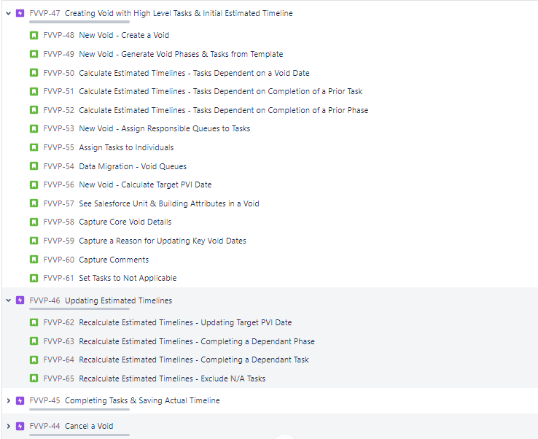
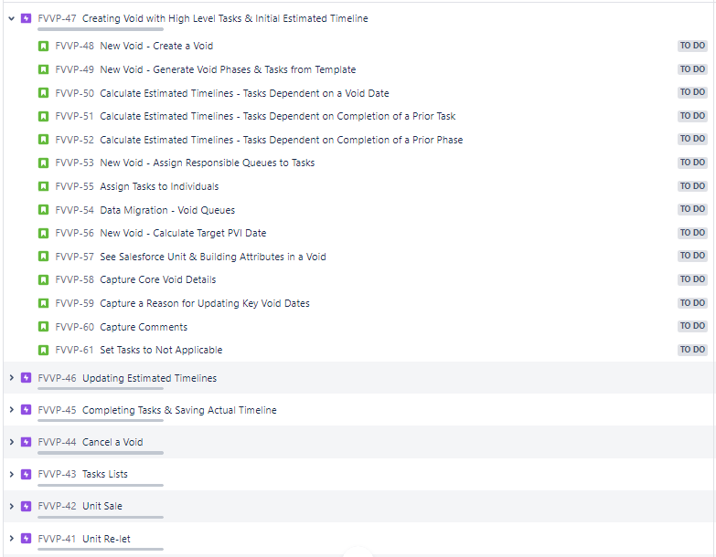
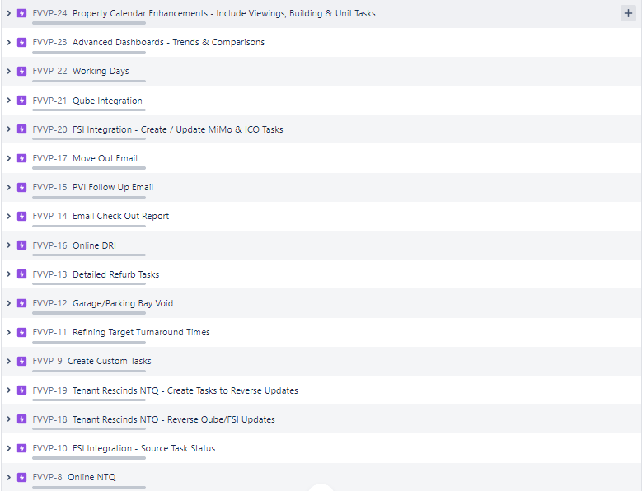
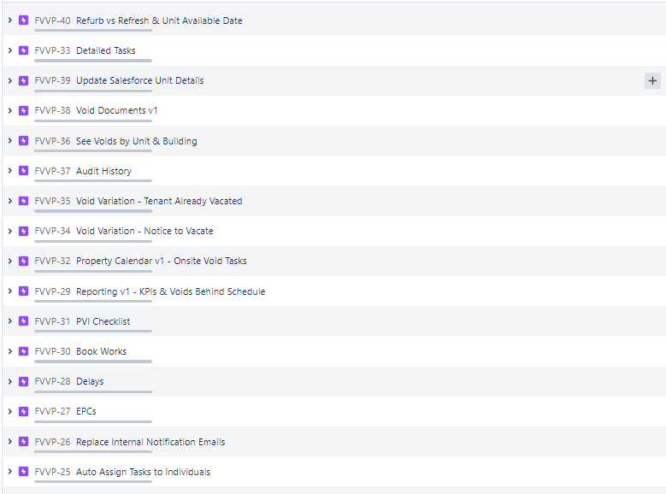
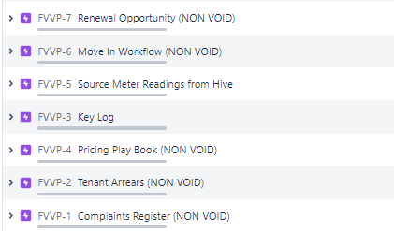
Jira Feature Backlog

Slide 24
Proposed Data Model

Slide 25



Agile Delivery Approach
Iterative delivery is achieved through a series of 3-week sprints
Process Improvement
Sprint Retrospective
Open Box Activity
<CRE Client> Activity
Joint Activity
Daily Stand-up
3-week Sprint
Sprint Planning
Sprint Demo
Testing
Product Increment
Sprint Backlog
Product Backlog
Backlog Refinement & Prioritisation
Backlog Refinement
Feedback
Notes:
An agile delivery approach allows early delivery of outcomes & provides flexibility to adjust for opportunities or issues uncovered during the project.
A living backlog will track outcomes to be delivered & relative priority. This will evolve as we collaborate towards maximising value delivered.
The delivery team will meet <CRE Client> representatives every 3 weeks to demonstrate the outcomes delivered in the past 3-week period & plan which outcomes will be worked on in the next 3-week period.
Feedback will be incorporated into the backlog and updated forecasts will be communicated.

Slide 26
Future-State Process: Void Workflow Example

